Slide 1
Color Theory
The Color Wheel

Slide 2
All About Color:
Chroma This is the intensity, strength, or purity of a color.
Squeezing paint directly from the tube to the palette is 'full Chroma'.

Slide 3
All About Color:
Hue
Hue is another word for color. The attribute which describes colors by name, i.e. red, blue, yellow etc.
Chroma and Hue can also be called “Pure Color”
There is no white or black added to it

Slide 4
All About Color:
White
+ Red
= Pink
Always use your lightest color first.
To make a tint, always use white and add more pure color
Tint Adding white with a color to make it lighter.
The opposite of shade.

Slide 5
All About Color:
Blue
Black
Dark Blue
Shade Adding black to a color to make it darker.
The opposite of shade is tint.
Shade is the opposite from Tint even in how it is applied. To make a shade,
use the pure color first, and then add black until you find the shade you want.

Slide 6
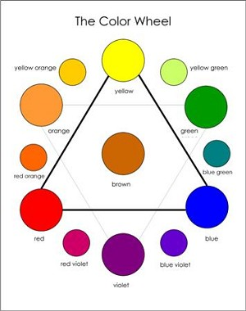
All About Color:
Primary Colors:
Red, Yellow, Blue
Secondary Colors:
Orange, Green, Violet
Tertiary/Intermediate Colors:
Red Orange, Yellow Orange, Yellow Green, Blue Green, Blue Violet, Red Violet

Slide 7
What you will be making:
You will be creating your own color wheel. You will only have Red, Blue and Yellow.
Use these three to make Green, Purple, and Orange.
From there you make Red Orange, Yellow Orange, Blue Green, Yellow Green, Red Violet, and Blue Violet.
So: 3 Primary, 3 Secondary, and 6 Intermediate colors. ADD black and white to create a tint and shade of each color as well.
Got That??

Slide 8
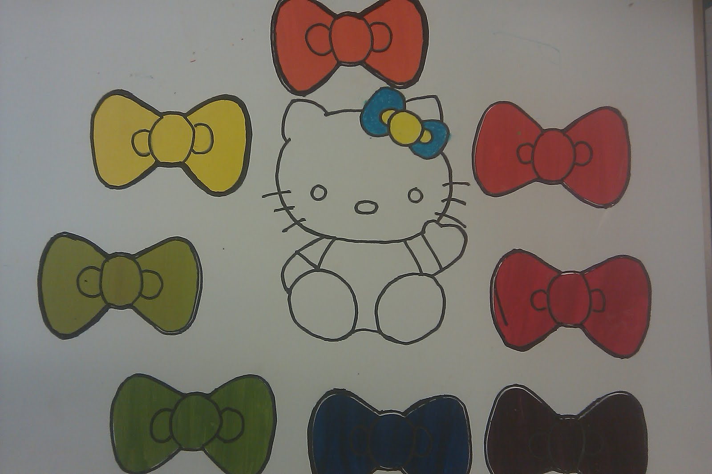
12 Hues + 12 tints + 12 Shades = 36 total
Each color will be in a shape that you design in a theme.
1st: Use your sketchbook to come up with a theme and the shape you will use.
2nd: In roughly 3-5in. squares (whichever fits your shape) Create your 36 total needed colors.
3rd: Trace your shape template onto your colors, cut them out, and glue them into a color wheel.

Slide 9
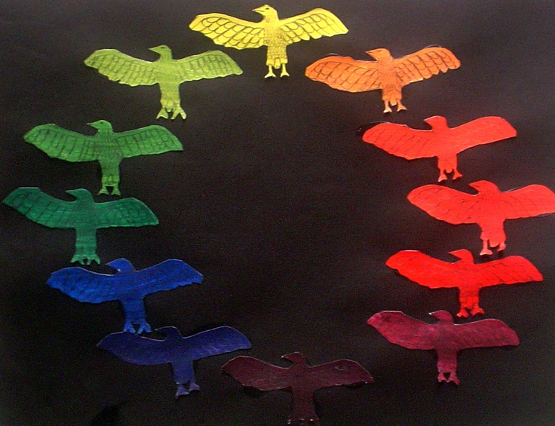
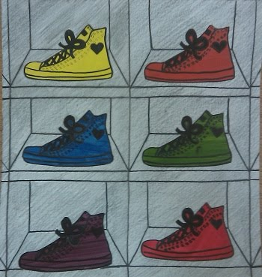
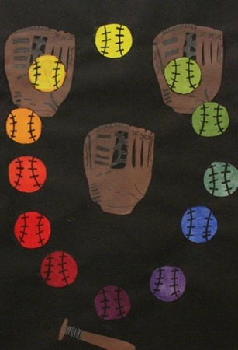
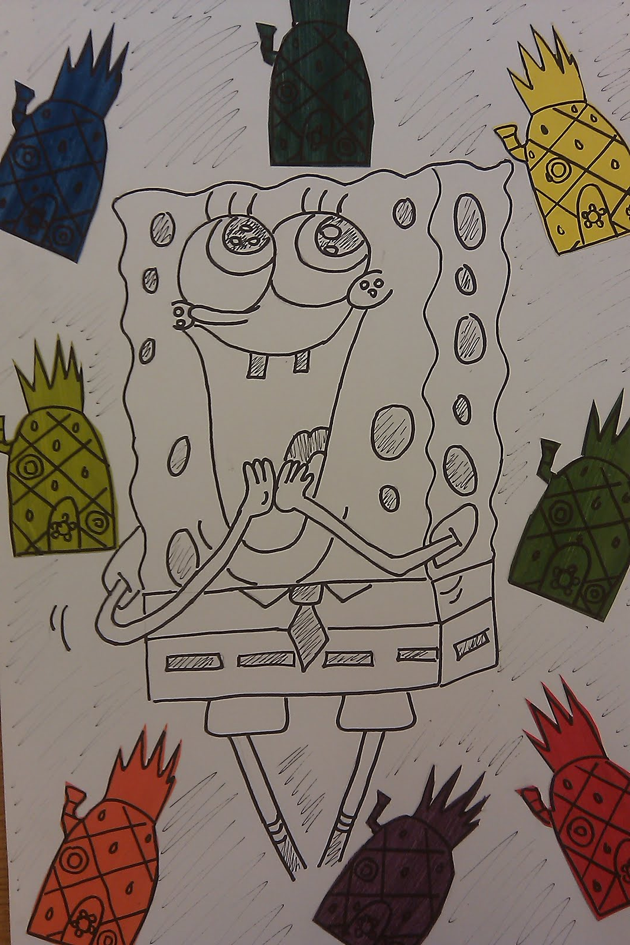
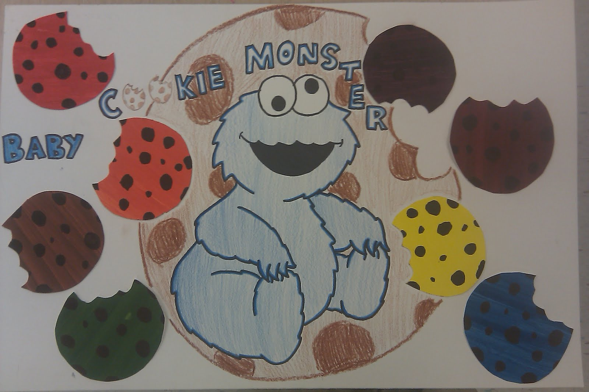
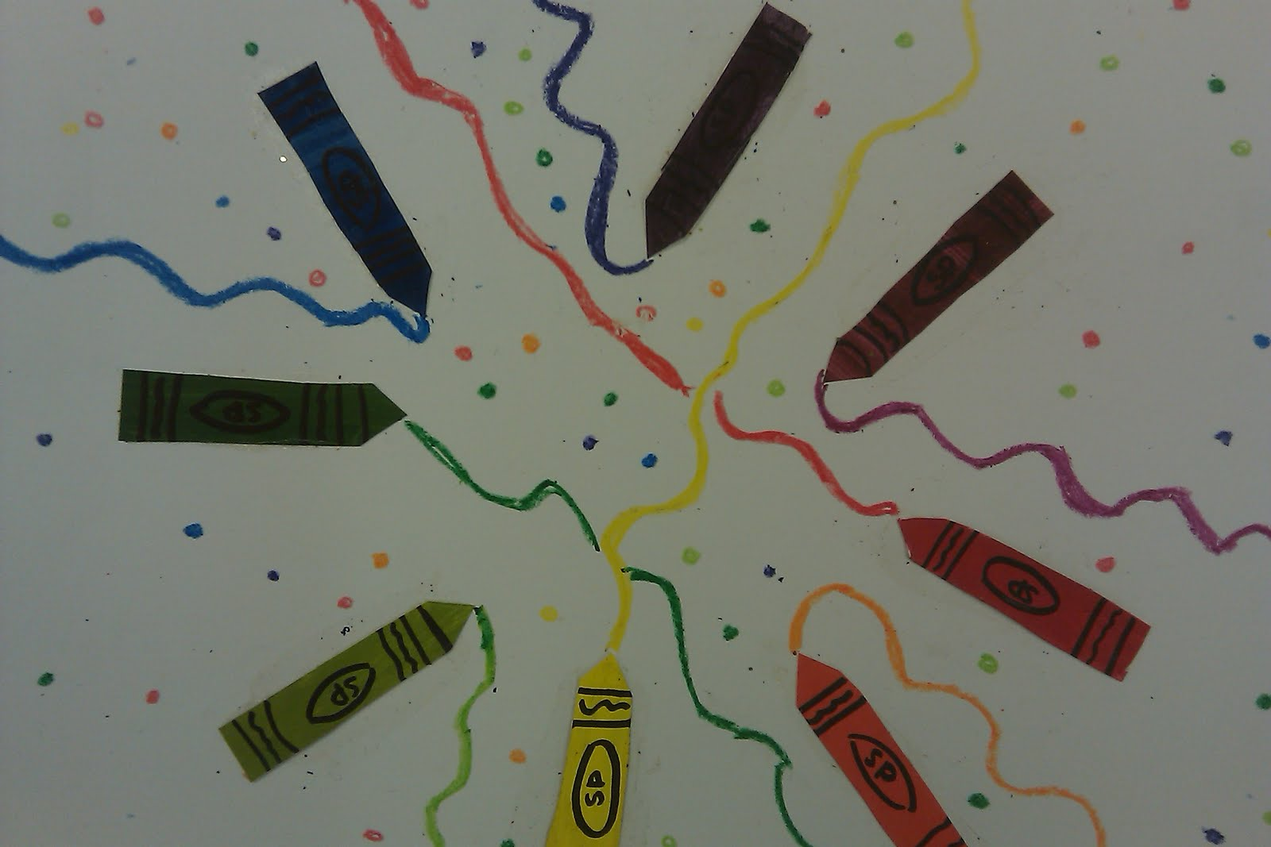
Examples

